Slide 1
Pemrograman jaringan
Prodi s1 Teknik informatika
Institut teknologi sepuluh nopember

Slide 2
outline
Pengiriman data pada socket: bytes
Pengiriman objek: object serialization
Contoh
TLS/SSL

Slide 3
Klien-Server: Mengirim Bytes
Data bertipe data bytes
Klien
Request
Server
Response

Slide 4
Klien-Server: Mengirim Objek
Data bertipe objek
Klien
Request
Server
Response
Objek ini harus dikonversi dulu ke bytes
Objek bisa berupa pickle, JSON, XML, dll

Slide 5
Object Serialization
Mengirim data berupa objek via socket
Keuntungan:
Memudahkan pengiriman data
Tidak perlu parsing (concat + split)
Lebih praktis
Kekurangan:
Keamanan data

Slide 6
Object Serialization
Objek “dibungkus” sebelum dikirim oleh klien
Lalu di server, objek “dibuka” dan dibaca isinya
Dan sebaliknya,
Respon objek “dibungkus” oleh server lalu dikirim klien
Klien “membuka bungkusan” dari server

Slide 7
Object Serialization
1) Klien: data bertipe objek, “dibungkus” menjadi bytes
2) Server: data objek “dibuka” dan bisa langsung diproses
Klien
Request
Server
Response
3) Server: respon dibungkus kembali
4) Klien: “membuka bungkusan” dari server

Slide 8
Implementasi di python
Pickle: The pickle module implements binary protocols for serializing and de-serializing a Python object structure.
https://docs.python.org/3/library/pickle.html
Marshal: This module contains functions that can read and write Python values in a binary format.
https://docs.python.org/3/library/marshal.html

Slide 9
Contoh di Python: pickle standalone
# declare a list
mylist = []
# assigning value to list
mylist.append('This is string') # string
mylist.append(5) # integer
mylist.append(('localhost', 5000)) # tuple

Slide 10
Contoh di Python: pickle standalone
# print list
print(mylist)
----- pembungkusan objek -----
# pickle object (in this example, the object is a list)
p = pickle.dumps(mylist)
print(p)
----- membuka bungkusan -----
# unpickle object
u = pickle.loads(p)
print(u)

Slide 11
Contoh di python
Data dari klien dan server dengan object serialization
https://github.com/studiawan/network-programming/tree/master/bab08

Slide 12
JSON dan xml
Protocol needs to be usable from other programming languages
Universal standards instead of formats specific to Python
Per the JSON standard, we need to encode its strings as UTF-8 for transmission on the wire.

Slide 13
compression
Since the time necessary to transmit data over the network is more significant
Than the time of CPU spends preparing the data for transmission
Example of compression algorithm: zlib
https://docs.python.org/3/library/zlib.html

Slide 14
Contoh json
https://github.com/studiawan/network-programming/tree/master/bab08

Slide 15
tLs/ssl
SSL: Secure Socket Layer (1995)
TLS: Transport Layer Security (1999)
Successor of SSL
TLS can verify server identity and to protect data in transit

Slide 16
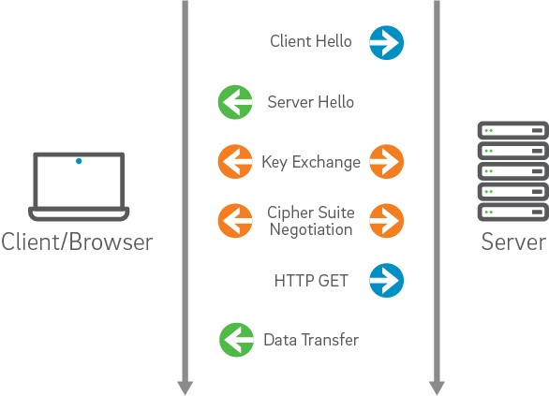
tLs/ssl
Sumber: https://certs.securetrust.com/support/support-how-ssl-works.php

Slide 17
Implementasi di python
ssl
https://docs.python.org/3/library/ssl.html
This module provides access to Transport Layer Security (often known as “Secure Sockets Layer”) encryption and peer authentication facilities for network sockets, both client-side and server-side.
This module uses the OpenSSL library.

Slide 18
Contoh ssl
https://github.com/brandon-rhodes/fopnp/tree/m/py3/chapter06

Slide 19
Panduan github classroom

